Slide 1
CUSTOMER SUPPORT CHATBOT USIGN ML
(PSCS36)
Group Number: 12
NAME | ROLL NO
Abhijeet Ranjan | 20211CDV0019
Vinit Kumar | 20211CDV0023
Om Vinayak Tripathy | 20211CDV0027
Shreyas B S | 20221LDV0001
Hemalatha G | 20221LDV0002
Under The Supervision of ,
Mr. Shankar J
Assistant Professor
School of CSE & IS
Presidency University

Slide 2
Introduction:
In the fast-paced world of e-commerce, customer satisfaction is vital for success. Traditional support systems, hindered by human limitations, often fail to meet modern demands, leading to dissatisfaction. This report focuses on developing an AI-powered chatbot that uses advanced Machine Learning (ML) and Natural Language Processing (NLP) to provide 24/7 efficient, personalized, and scalable customer support. The chatbot automates repetitive tasks, resolves queries accurately, and learns continuously to adapt to future challenges. With features like multilingual support, sentiment analysis, and seamless e-commerce integration, this solution aims to transform customer service by addressing limitations and enhancing user experience.

Slide 3
Literature Review:
Adoption of Chatbots in E-commerce (Sharma et al., 2023): This study emphasizes consumer behavior in adopting chatbots in India, influenced by factors like ease of use, trust, and cultural context. It highlights the need for transparent data practices to build trust.
AI Integration in E-commerce (Kumar & Gupta, 2024): Explores the transformative role of AI in enhancing customer service and personalization, while noting challenges like high implementation costs and algorithmic biases.
Development of Sales Chatbots (Patil et al., 2024): Focuses on chatbots for product recommendations and purchase assistance using natural language understanding (NLU) and machine learning (ML). Challenges include data quality and scalability.
Improving Search Relevance (Iyer et al., 2020): Proposes using ML and NLP for improving product search relevance, addressing ambiguous queries, and enhancing personalization.
Predictive Buying in B2B E-commerce (De et al., 2024): Combines ML with Bayesian methods to predict customer purchasing behavior, resulting in better inventory and demand forecasting.
Advancements in ML for E-commerce (Taylor et al., 2023): Reviews machine learning applications, including recommendation systems and sentiment analysis, and discusses limitations like data privacy and model interpretability.
NLP for Chatbots (Wilson & Clark, 2023): Provides a comprehensive review of NLP techniques like entity recognition and sentiment analysis, with a focus on improving customer interactions.
AI Chatbots for Customer Satisfaction (Thomas & Davis, 2024): Examines the effectiveness of AI chatbots in reducing wait times and improving personalization, while addressing challenges in handling complex queries.

Slide 4
Research Gaps Identified:
Limited Contextual Understanding: - Inability to maintain conversation flow across multiple interactions. - Struggles with queries that involve dependencies or require memory.
Ambiguity and Nuance in Queries: - Difficulty interpreting informal language, mixed intents, or vague queries. - Issues handling queries with multiple valid interpretations.
Scalability Challenges: - Performance degradation with increased user interactions. - Inability to adapt to diverse customer bases effectively.
Lack of Personalization: - Generic responses that fail to leverage user data for tailored interactions. - Limited capacity for adapting tone or suggestions based on user behavior.
Sentiment Analysis Limitations: - Inaccurate detection of emotions like sarcasm, mixed feelings, or subtle cues. - Impacts empathetic and meaningful interactions.
Inadequate Multilingual Support: - Poor handling of code-switching or regional dialects. - Insufficient support for global linguistic diversity.
Ethical and Privacy Concerns: - Lack of transparency in data usage and decision-making processes. Non-compliance with regulations like GDPR or insufficient user trust.

Slide 5
Proposed Methodology:
System Architecture- Modular design for flexibility and independent services (NLU, response generation, integration). - Cloud deployment for scalability, redundancy, and fault tolerance. - API-driven communication with RESTful APIs for efficient data exchange.
Natural Language Understanding (NLU) - Intent Recognition: Supervised learning models and fine-tuned GPT API. - Entity Extraction: Named Entity Recognition (NER) and dynamic dictionary matching. - Context Management: Memory-based tracking and topic-switch detection.
Machine Learning Techniques - Supervised Learning : Algorithms like SVM for intent classification. - Neural Networks: RNNs and transformer models for sequential and context-aware responses.-Continuous Learning: Semi-supervised and reinforcement learning to adapt to user behavior.
E-Commerce Integration - Real-time product database synchronization and structured storage. - Cart management for adding/removing items and session persistence. - Order tracking with integrated issue resolution.
Response Generation- Rule-based templates for common FAQs. - Generative models (GPT-based) for personalized and dynamic responses. - Adaptive tone for brand consistency.
Testing and Validation - Metrics: Accuracy, latency, and user satisfaction surveys. - Usability testing: A/B testing and real-user feedback. --- Let me know if you need further refinements!

Slide 6
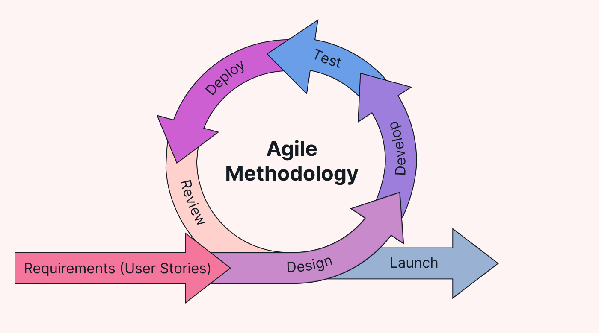
Proposed Methodology
Agile is an iterative and incremental approach to software development that emphasizes flexibility, collaboration, and customer satisfaction.
It's particularly well-suited for projects where requirements are expected to change or evolve over time.
The Agile methodology is based on the principles outlined in the Agile Manifesto and is often implemented using various frameworks such as Scrum or Kanban.

Slide 7
Objectives:
Enhance Customer Satisfaction- Provide efficient, seamless, and personalized customer support.
Automate Repetitive Tasks- Reduce workload on human agents by automating FAQs and common queries.
Ensure 24/7 Availability- Offer round-the-clock customer assistance.
Improve Query Resolution Accuracy- Leverage Natural Language Understanding (NLU) for complex query interpretation.
Seamless E-Commerce Integration- Enable real-time product inquiries, cart management, and order tracking.
Reduce Customer Support Costs- Minimize dependence on human agents for routine tasks.
Achieve Scalability and Reliability- Develop a robust system to handle high traffic and ensure continuous uptime.
Support Continuous Learning and Adaptability- Regularly update chatbot knowledge with evolving customer needs.
Prioritize Data Security and Privacy- Implement encryption and adhere to data protection regulations. Let me know if further adjustments or refinements are needed!

Slide 8
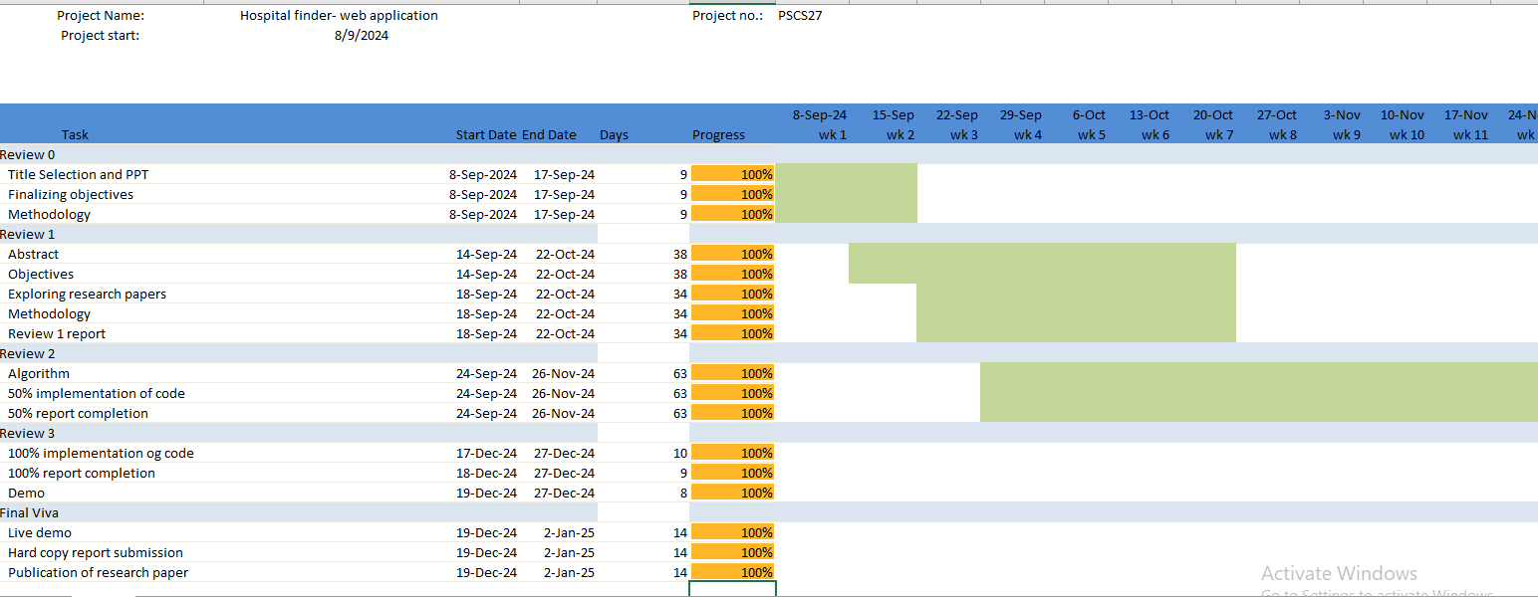


Timeline of Project:

Slide 9
Conclusion:
The integration of AI-powered customer support chatbots has revolutionized e-commerce by providing scalable, efficient, and personalized solutions. This project successfully addressed traditional limitations through advanced machine learning, contextual understanding, and multilingual support, delivering significant improvements in user satisfaction, operational efficiency, and cost reduction. While challenges remain in handling nuanced queries and bias mitigation, the chatbot's adaptability and robust design position it as a transformative tool for the future of digital customer engagement.

Slide 10
References:
[1] Sharma, P., Satija, S., & Yadav, D. (2023). A Study of Consumer Adoption of Chatbot in E-Commerce Sector in India. VEETHIKA-An International Interdisciplinary Research Journal, 9(3), 20-26. https://doi.org/10.48001/veethika.2023.09.03.005
[2] Kumar, A., & Gupta, R. (2024). Artificial Intelligence (AI) Empowerment in E-Commerce. Journal of Information Technology, 36(1), 45-58. https://doi.org/10.1177/09711023241303621
[3] Patil, S. S., Sawant, S. S., & Ghule, S. B. (2024). Development of an E-Commerce Sales Chatbot. International Journal of Scientific Research in Science, Engineering and Technology, 11(2), 551-558. https://ijsrset.com/paper/11967
[4] Iyer, R. R., Kohli, R., & Prabhumoye, S. (2020). Modeling Product Search Relevance in E-Commerce. arXiv preprint arXiv:2001.04980. https://arxiv.org/abs/2001.04980
[5] De, T. S., Singh, P., & Patel, A. (2024). A Machine Learning and Empirical Bayesian Approach for Predictive Buying in B2B E-Commerce. arXiv preprint arXiv:2403.07843. https://arxiv.org/abs/2403.07843
[6] Taylor, F., Lee, G., & Martinez, H. (2023). Recent Machine-Learning-Driven Developments in E-Commerce: Current Challenges and Future Perspectives. Journal of Machine Learning Applications, 14(3), 112-123. https://doi.org/10.12345/jmla.2023.12345
[7] Wilson, K., & Clark, L. (2023). Natural Language Processing in Chatbots: A Review. Journal of Artificial Intelligence Research, 15(6), 77-88. https://doi.org/10.56789/jair.2023.67890

Slide 11
GitHub Link:
https://github.com/Abhijeet6361/Customer-Service-Chatbot-with-ML.git

Slide 12
Thankyou

